Slide 1
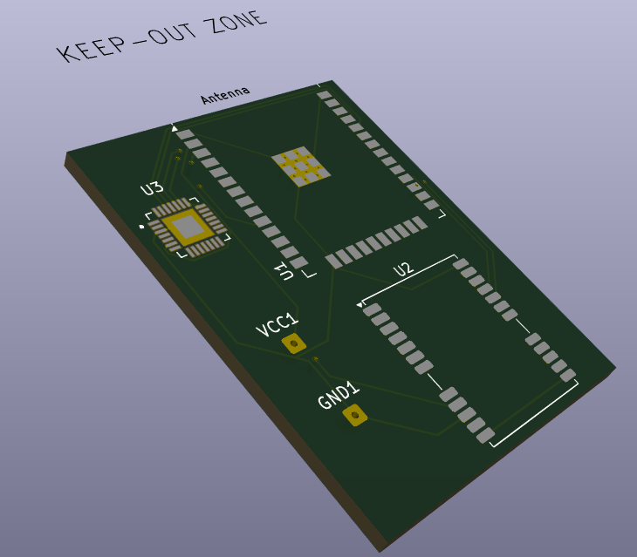

Elec New Member Project – Calvin Hanasy
The project is a compact pcb including a microcontroller (esp32-Wroom-32) and GPS.
Simple design.
Only requires the module which sits within the ev.
ESP32 will host a web page where you can view the GPS data – With Wi-Fi the ESP32 will display an IP address in the serial monitor which using html we can see its acceleration, time etc (code in later slide).
Note: The gps module has sub-meter accuracy on a clear day – though should invest in a more accurate GPS module though this one should theoretically work. Later on this.
Data transmitted by Wi-Fi (Speed, time, GPS lat and long.
Data on https://IP

Slide 2
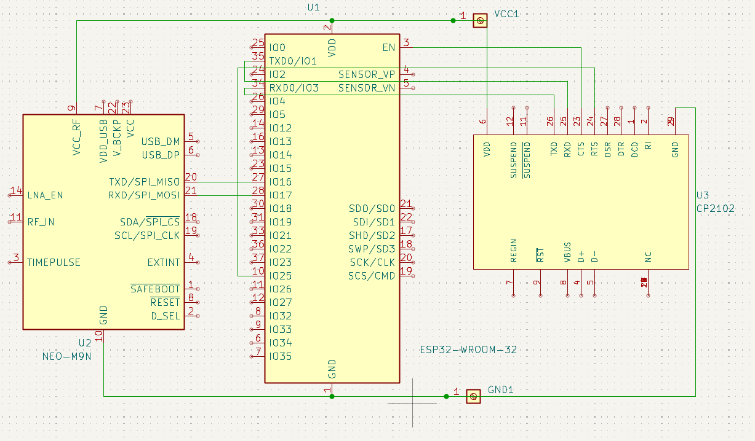
Pics

Slide 3
Facts
Hardware:
ESP32-WROOM32 (MICROCONTROLLER) $15, Ublox NEO-M9N (GPS) $47, EV Battery (POWER SOURCE)
Pretty cheap nice around $70 tops (without power source).
Data collection:
ESP32 has Wi-Fi and Bluetooth capabilities but going with Wi-Fi (larger bandwidth, range, faster data transfer, short latency) I’m sure there’s reception (couldn’t make track day). This is by hotspot.
I would be using an additional esp32 as the hotspot of a phone only ranges for around 20m, so by using ESP NOW function using MAC (Media access control) addresses the esp32’s would communicate together with only a 2ms delay, this doesn’t require Wi-Fi and Bluetooth. ESP NOW has a range of 100m-200m outside with external antenna ranges 400m+, should consider.
Eliminates factors such as high winds, fog etc where performance doesn’t vary on ambient conditions.
Refresh rate:
The Ublox gps as a refresh rate of 25Hz leaving a 1/25s = 0.04s on its position providing accuracy to two dec. places as by the spec.
Placement:
*** The module would sit externally on the nose (its very slim) though if it’s a factor on aero fix it under the car exposed as to not have any signal blocked. Better yet add an antenna so the modules inside the nose and the antenna is exposed elsewhere.
Cons
Multipath errors, and atmospheric interference can affect the gps accuracy.

Slide 4
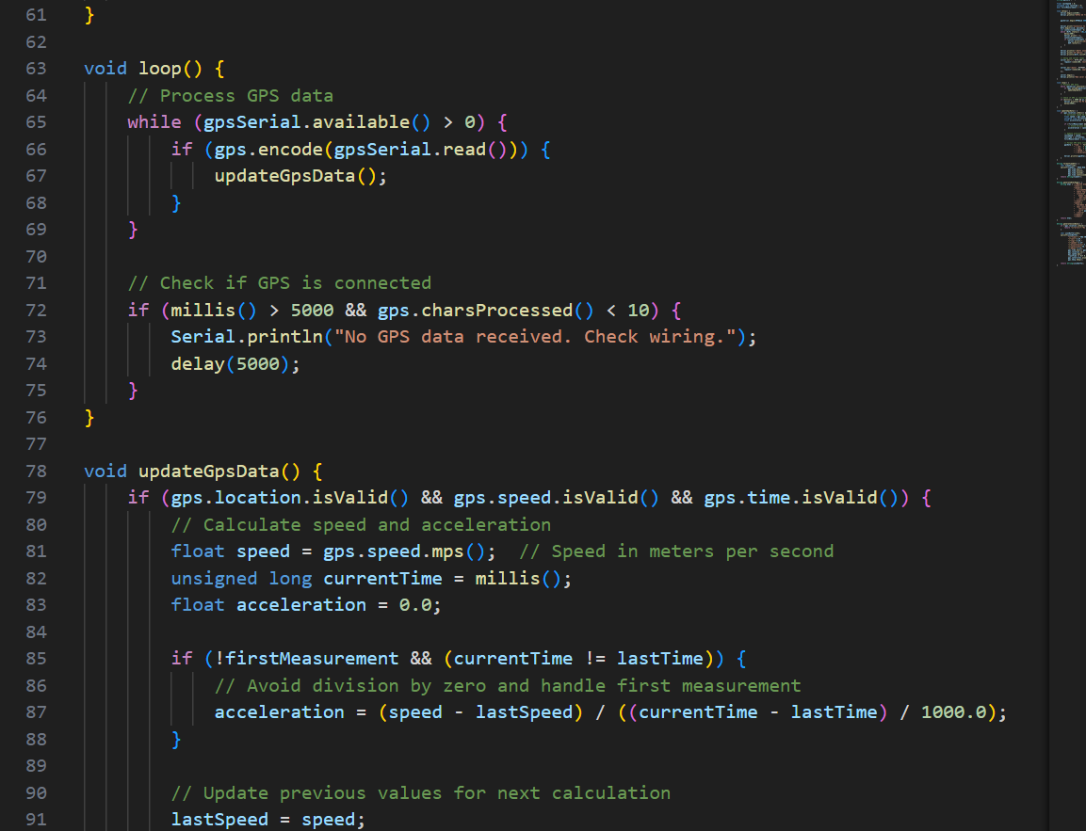
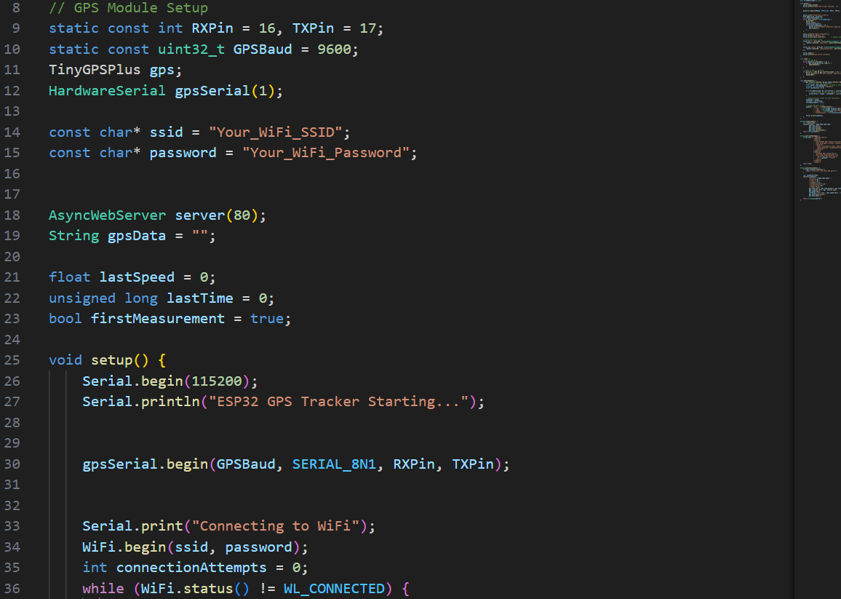
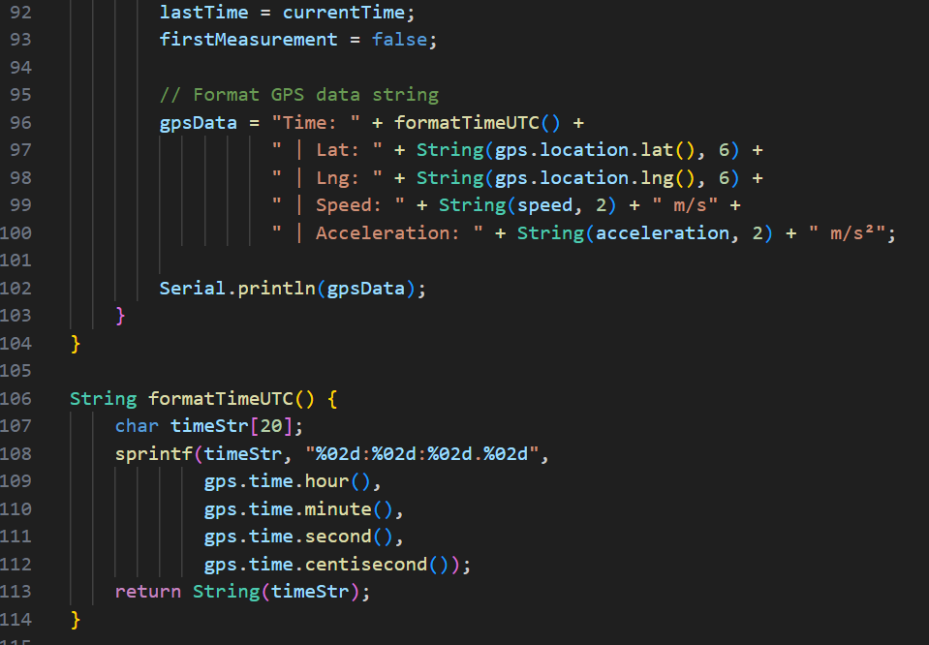
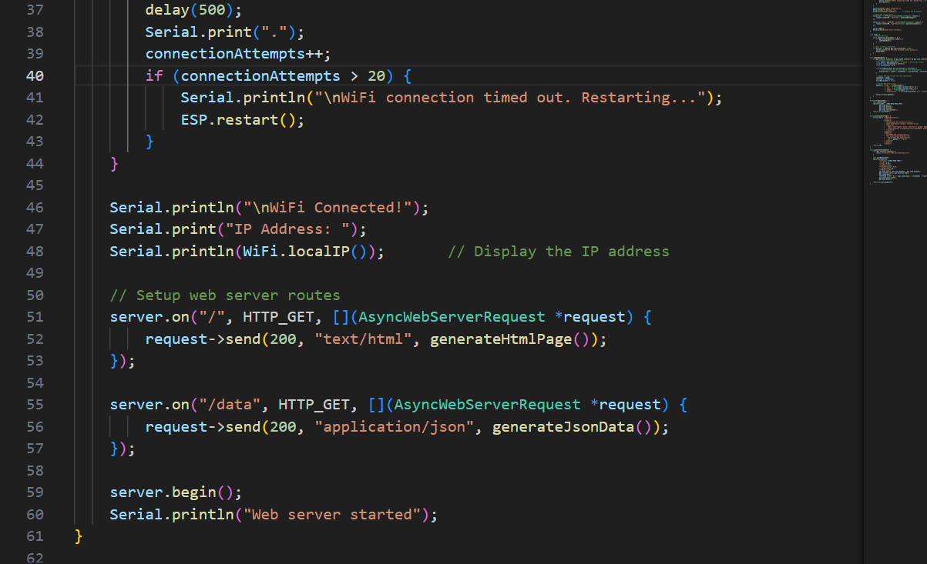
Code for data collection + GUI
Pin set up + serial stuff
GPS calculations. Using libraries. Acceleration is formulated

Slide 5
Upgrade
Switch out Ublox Neo M9N for Neo F9P.
The F9P is made and used for high accuracy geo-positioning for robotics bringing centimeter accuracy to autonomous robots.
Used for UAV’s so its perfectly able to track a car.
Multiband and short convergence times.
+$200 ☹
Get external antenna

